Slide 1
PLAY STORE APP REVIEW ANALYSIS
CAPSTONE PROJECT
Presented By:
Student Name- Rohit Kumar
College Name- Sitamarhi Institute of technology, Sitamarhi
Department- Computer Science Engineering

Slide 2
OUTLINE
Problem Statement (Should not include solution)
Proposed System/Solution
System Development Approach (Technology Used)
Algorithm
Result
Conclusion
Future Scope
References

Slide 3
PROBLEM STATEMENT
The Play Store apps data holds significant potential for guiding app development towards success. Extracting actionable insights from app categories, ratings, sizes, and customer reviews is crucial for developers aiming to capture the Android market. The challenge is to analyze the dataset comprehensively and identify key factors contributing to app engagement and success.

Slide 4
PROPOSED SOLUTION
The system aims to provide actionable insights for developers, enabling them to enhance their apps and capture the Android market effectively. The proposed solution involves data preprocessing, exploratory data analysis (EDA), feature engineering, and machine learning techniques to uncover patterns and key factors influencing app engagement and success.
Data Collection:
I have a Kaggle the data ,Gather historical data on a play store App Review, including review id, username, thumbs Up Count, and other relevant factors.
In data information have Range Index: 55744 entries, 0 to 55743 and total 13 columns.
Data Preprocessing:
I have done in which Handle missing values and count missing value, check duplicate value, clean data and Explore Unique Values.
Extract relevant features from the dataset.
Machine Learning Algorithm:
In machine Learning Algorithm I used Regression: Predicting a continuous outcome variable based on one or more predictor variables because Simple and Interpretable, good for understanding linear relationship between variables.
In which include Pair plot between score and count, Distribution of source , Distribution of Review over Time Visualization.
Evaluation:
I used Regression Problem in which Accuracy: 0.66666666 and Classification Report divided into precision, recall, f1-support and support, or also find mean absolute error:0.333333, Mean Square Error: 0333333, or other relevant metrics.

Slide 5
SYSTEM APPROACH
System requirements: I have done on IBM Cloud(notebook) platform
Library required to build the model
library used: Pandas, NumPy, Matplotlib, Seaborn, word cloud, Sci Py :-used to solve mathematical problem.
Machine learning: Regression, Classification

Slide 6
ALGORITHM & DEPLOYMENT
In the Algorithm section,
Algorithm Selection:
Predicting a continuous outcome variable based on one or more predictor variables because Simple and Interpretable, good for understanding linear relationship between variables. .
Data input:
have a Kaggle the data ,Gather historical data on a play store App Review, including review id, username, thumbs Up Count, and other relevant factors..
Training Process:
Done in which collect and clean data, Handle missing values and count missing value, check duplicate value, clean data and Explore Unique Value.
Prediction Process:
Using regression model to predict Historical data between frequency and score ,Distribution of over time

Slide 7
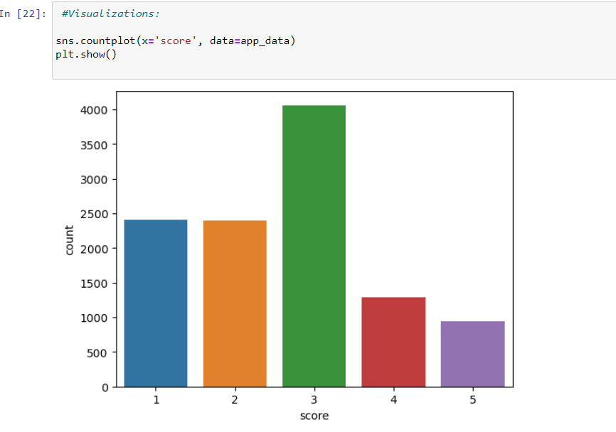
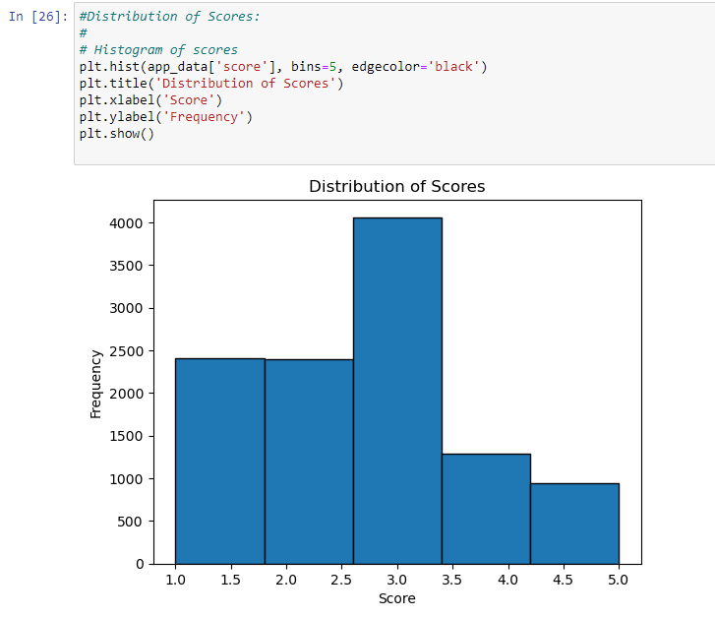
RESULT

Slide 8
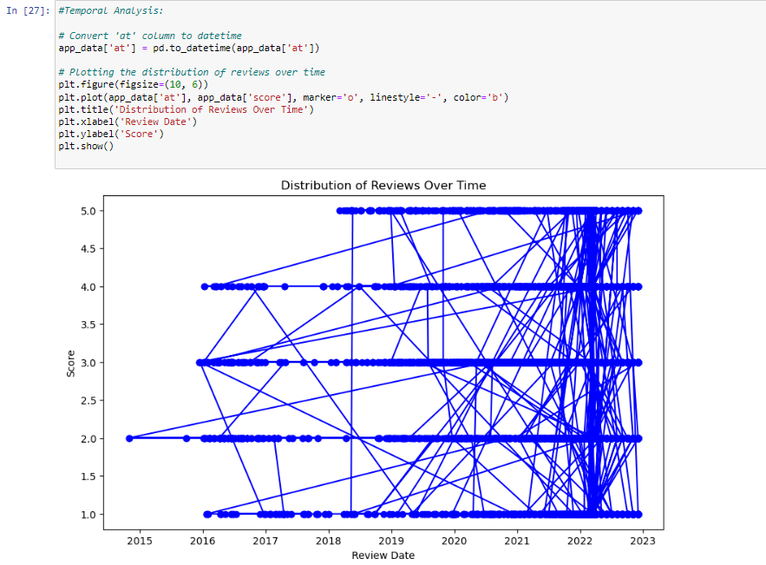
RESULT

Slide 9
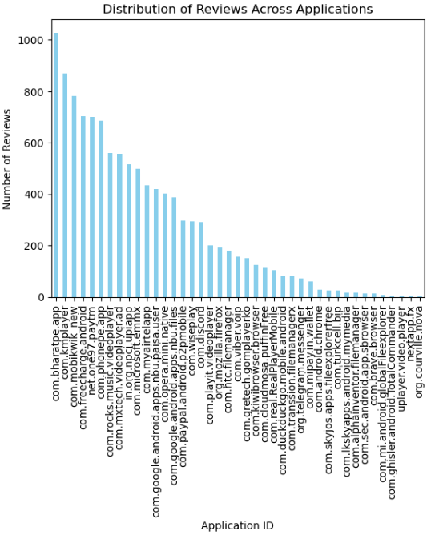
RESULT

Slide 10
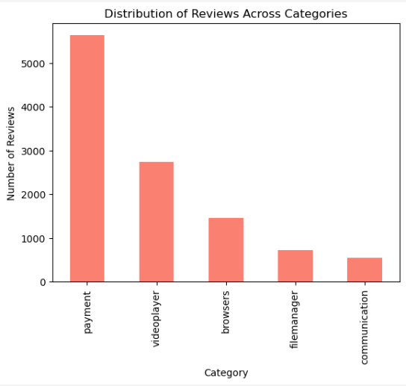
RESULT

Slide 11
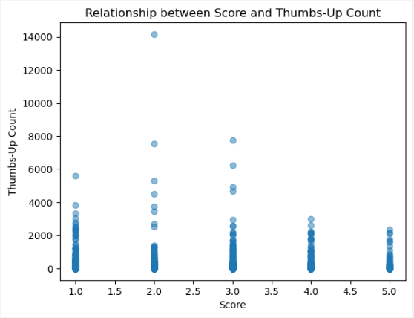
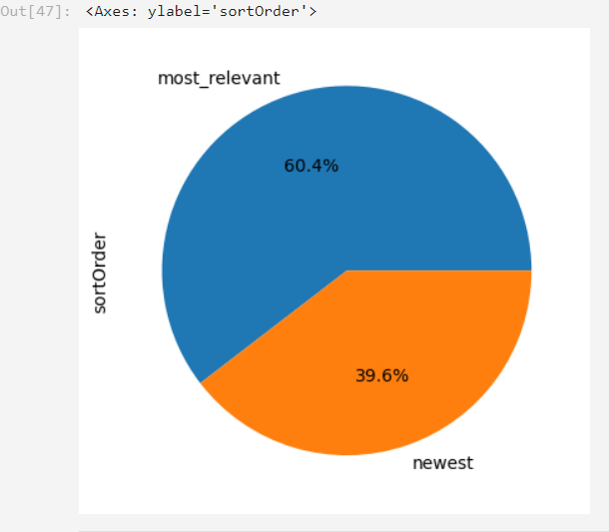
RESULT

Slide 12
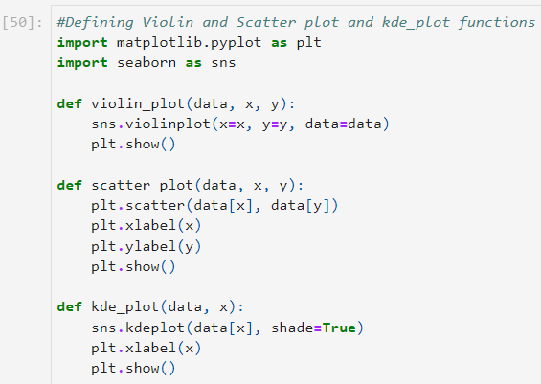
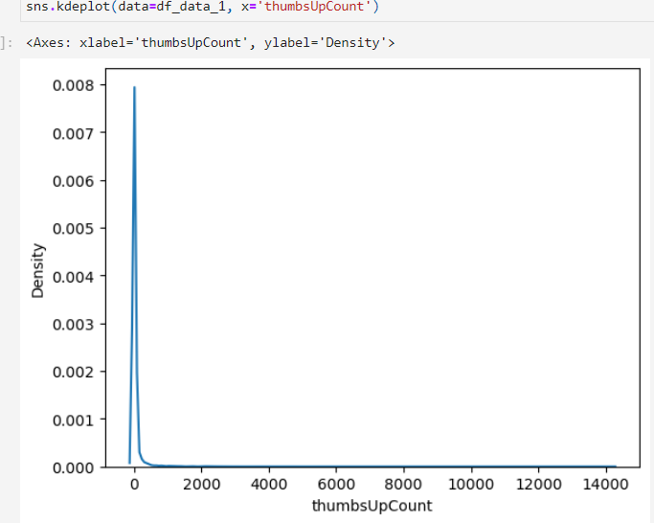
RESULT

Slide 13
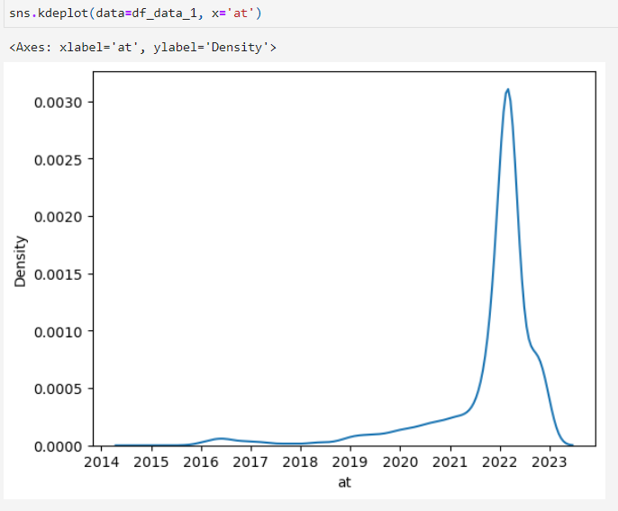
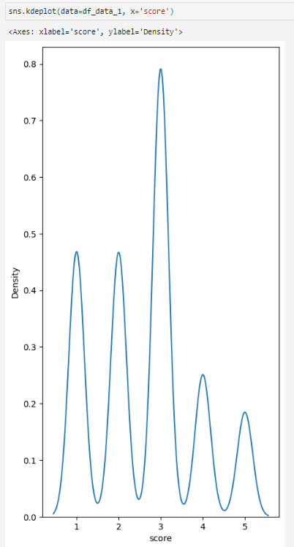
RESULT

Slide 14
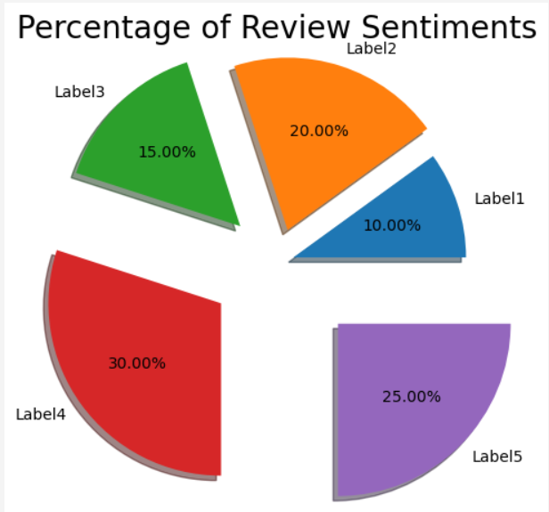
RESULT

Slide 15
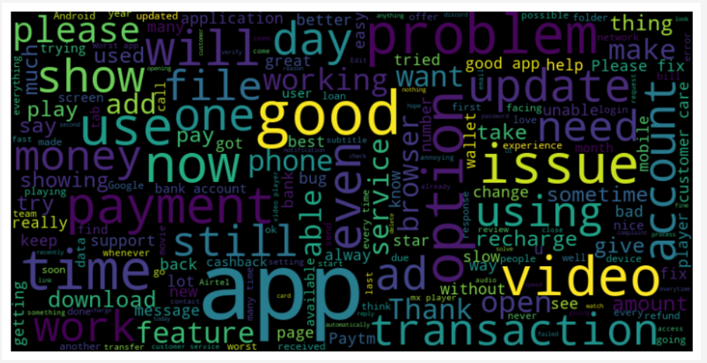
RESULT

Slide 16
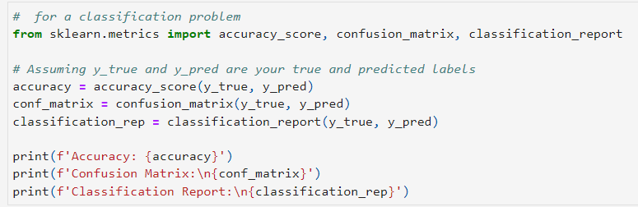
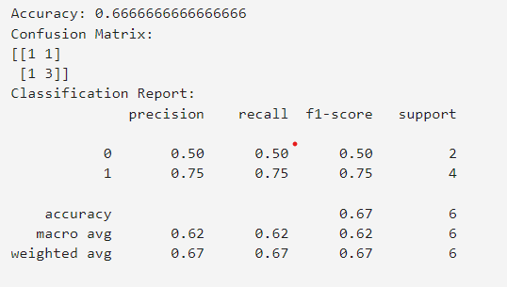
RESULT

Slide 17
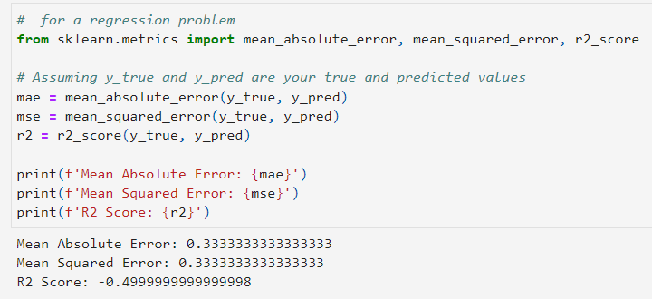
RESULT

Slide 18
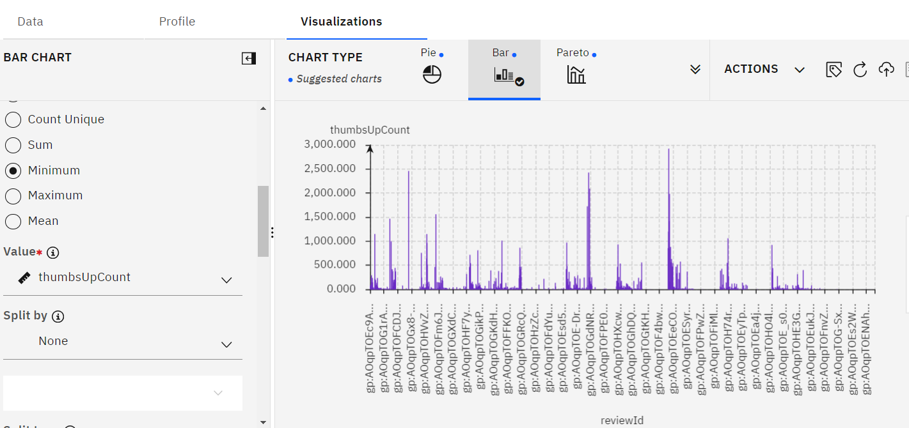
RESULT

Slide 19
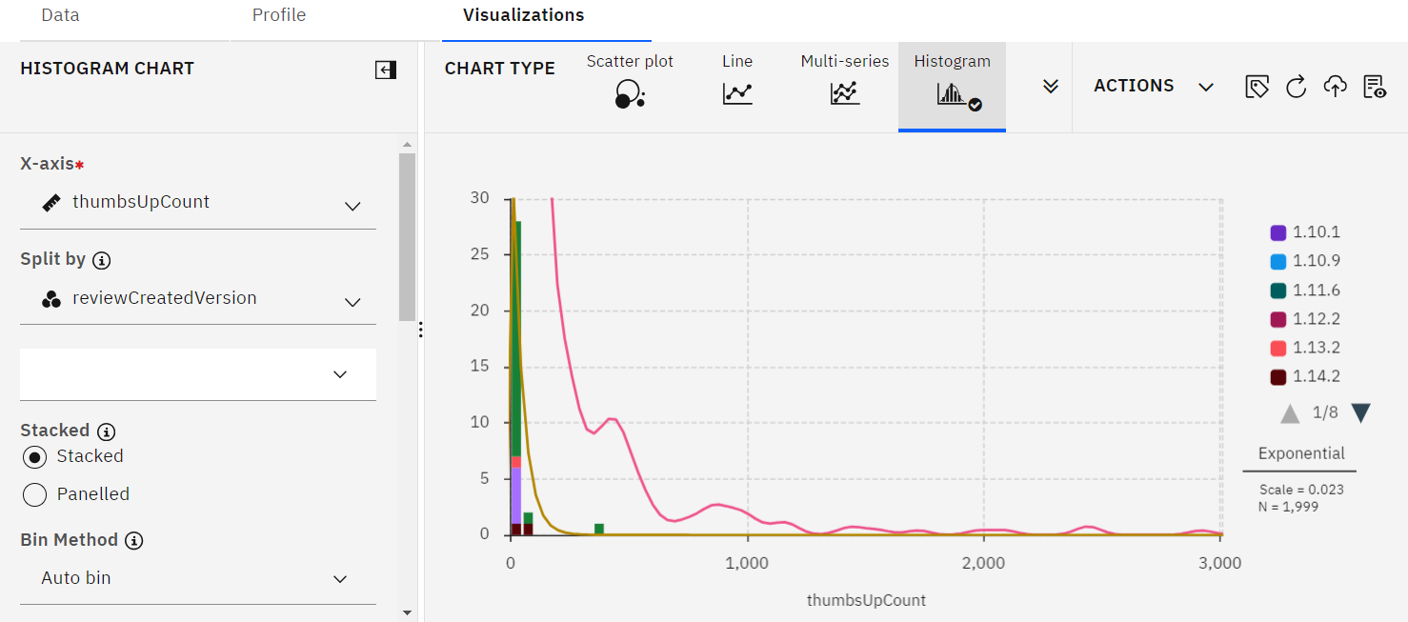
RESULT

Slide 20
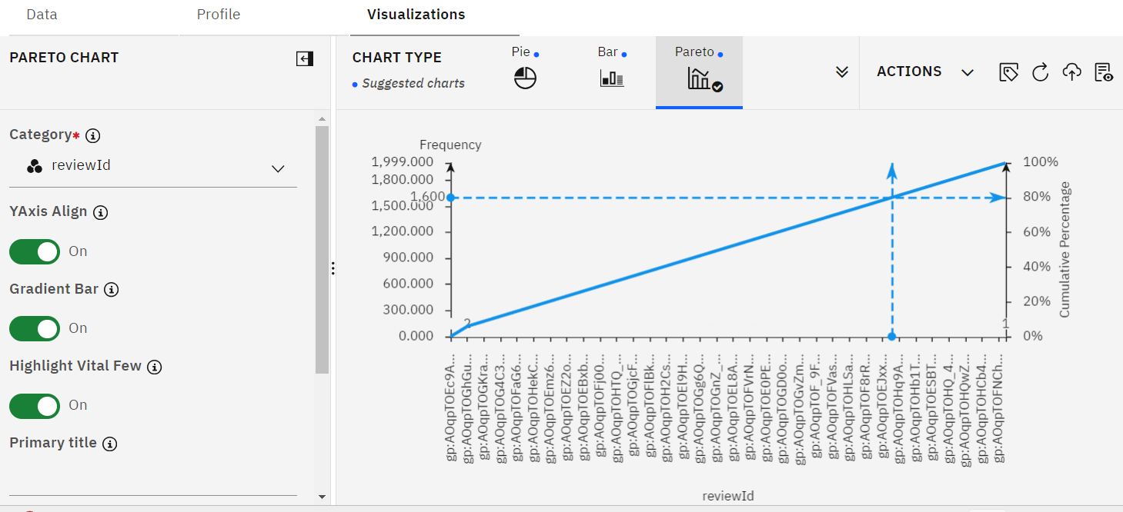
RESULT

Slide 21
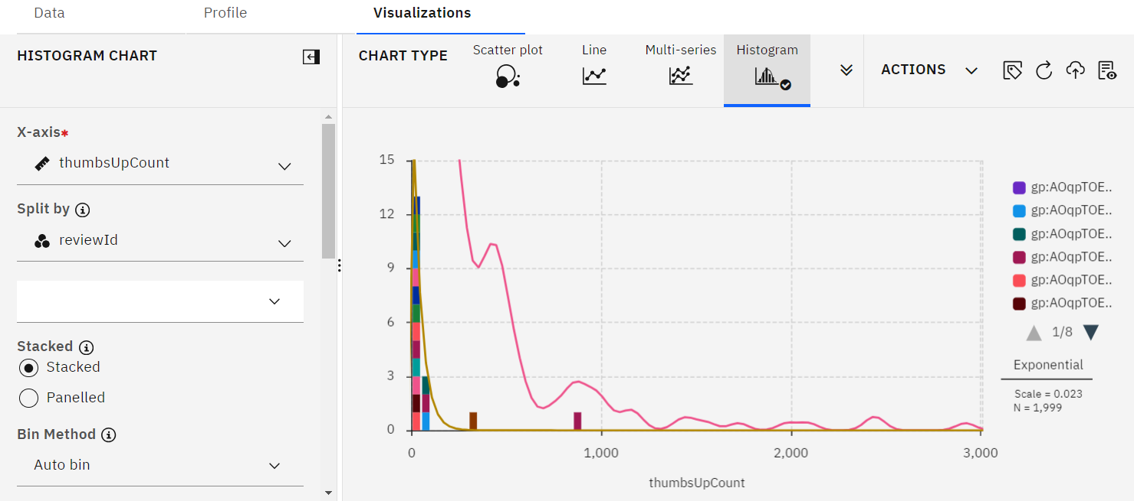
RESULT

Slide 22
CONCLUSION
The analysis aims to provide valuable insights for developers, enabling them to make informed decisions for app development and market capture.
the system employs a comprehensive approach encompassing data collection, preprocessing, and machine learning algorithms to provide developers with actionable insights for app enhancement and market success on the Android platform. Through thorough data analysis and application of regression techniques, the system achieves a notable accuracy of 0.66666666. Evaluation metrics such as precision, recall, and mean absolute error further contribute to a comprehensive understanding of the model's performance, emphasizing its potential utility for developers seeking to optimize their applications.

Slide 23
FUTURE SCOPE
optimizing the algorithm for better performance, and expanding the system to cover multiple cities or regions.

Slide 24
REFERENCES
I have collect data on the Kaggle.com.
With the help of ChatGPT.
Classification problem with the help of medium.com (website) and Followed mam’s lecture.

Slide 25
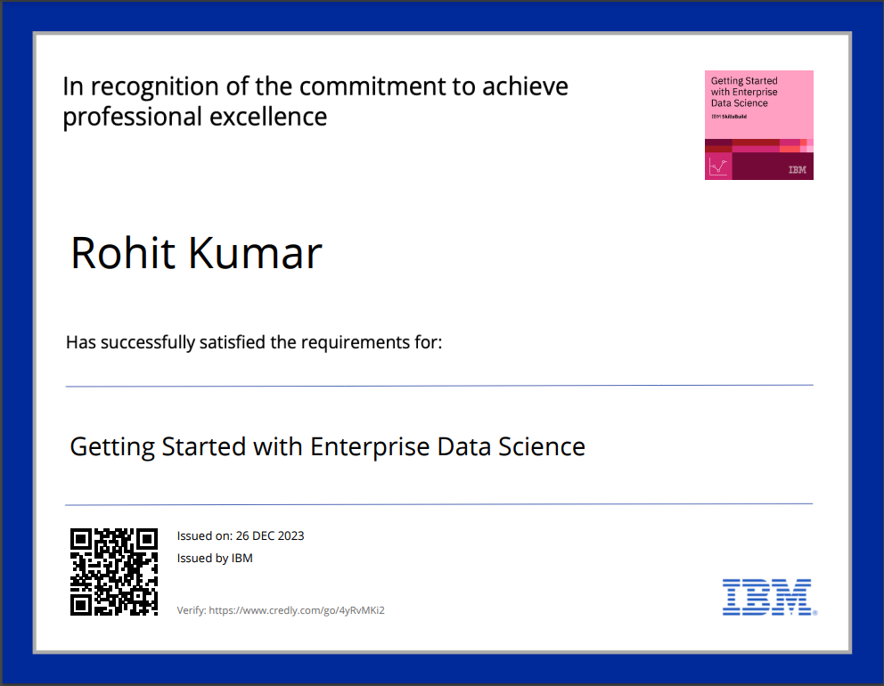
COURSE CERTIFICATE 1

Slide 26

COURSE CERTIFICATE 2

Slide 27
THANK YOU

